Slide 1
WALKWAY CASINO BY: ProjectX
BY: ProjectX
Created By: s223339237 (Yola Gcolotela), s220482152 (Beja Sibabalwe),
s219585709 (Msondezi Gwashu), s2223213047 (Hlathwayo Lwazi

Slide 2
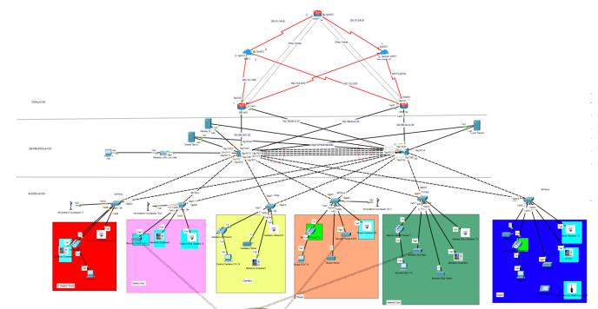
Given Information: The topology below

Slide 3
Network design Principle For The Network
Scalability
Redundancy:
Security
Performance
Availability
Load Balancing

Slide 4
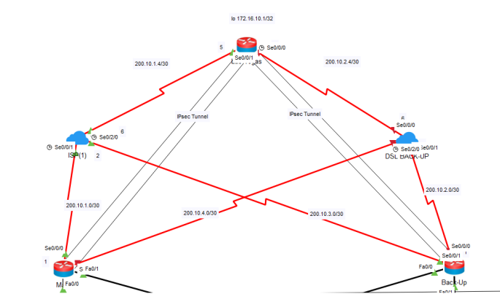
CORE LAYER

Slide 5
CORE LAYER(CONT)
On this layer we have configured the following :
VPN(IPSEC)Tunnel
Zone-Based Firewall
NAT(PAT)
Telephone Service
Default Routes and OSPF

Slide 6
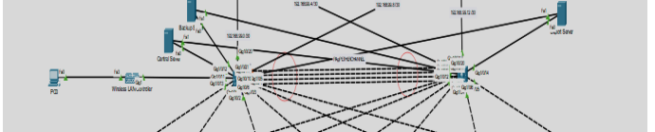
Distribution LayeR

Slide 7
Distribution Layer
EtherChannel (PAgP Protocol)
VTP (VLAN Trunking Protocol)
OSPF so that it can route packets to the core layer.
HSRP (Hot Standby Router Protocol)
DHCP (Dynamic Host Configuration Protocol)

Slide 8
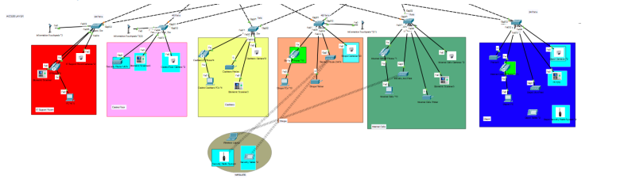
Access Layer

Slide 9
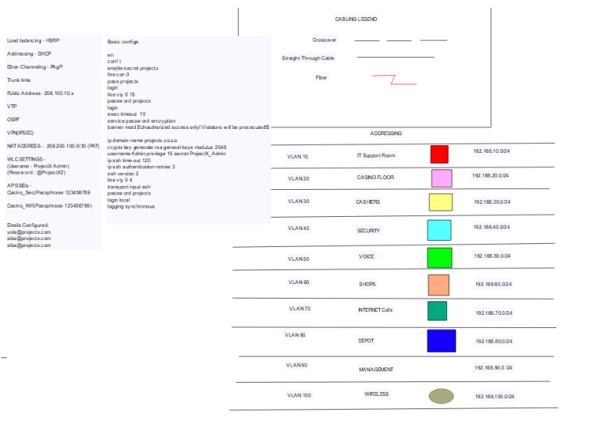

Slide 10
Access Layer
Vlans and port security security:
Violation of the port security
Inter vlan communication
Acess points connected to the wlc and its ssids

